Slide 1

CPEN 311: Digital Systems Design
Slide Set 19: High-Level Synthesis:
Forget VHDL and Verilog: Design Hardware by writing Software!
2016/2017 Term 1
Instructor: Steve Wilton
stevew@ece.ubc.ca
Slide Set 19, Page <number>

Slide 2
Learning Objectives
Learning objectives for this slide set:
1. To understand how high-level languages can be used to improve
programmer productivity
2. To understand the limitations and advantages of high-level synthesis
3. To have a high-level understanding of where this technology is today.
4. To understand some of the challenges that exist using HLS tools
5. To understand, at a high level, how high-level synthesis tools convert C to
hardware
The intention is not to give you enough information to design something using HLS
But, when you get out in the real world, you might have to make the call: for a given
project, should your company stick with current hardware-design tools, or should you
try this “new” approach? This slide set will give you a start at gathering information to
make this decision.
Slide Set 19, Page <number>

Slide 3
Verilog / VHDL is difficult, and design is time-consuming.
Wouldn’t it be great if you automatically convert software to hardware?
Slide Set 19, Page <number>

Slide 4
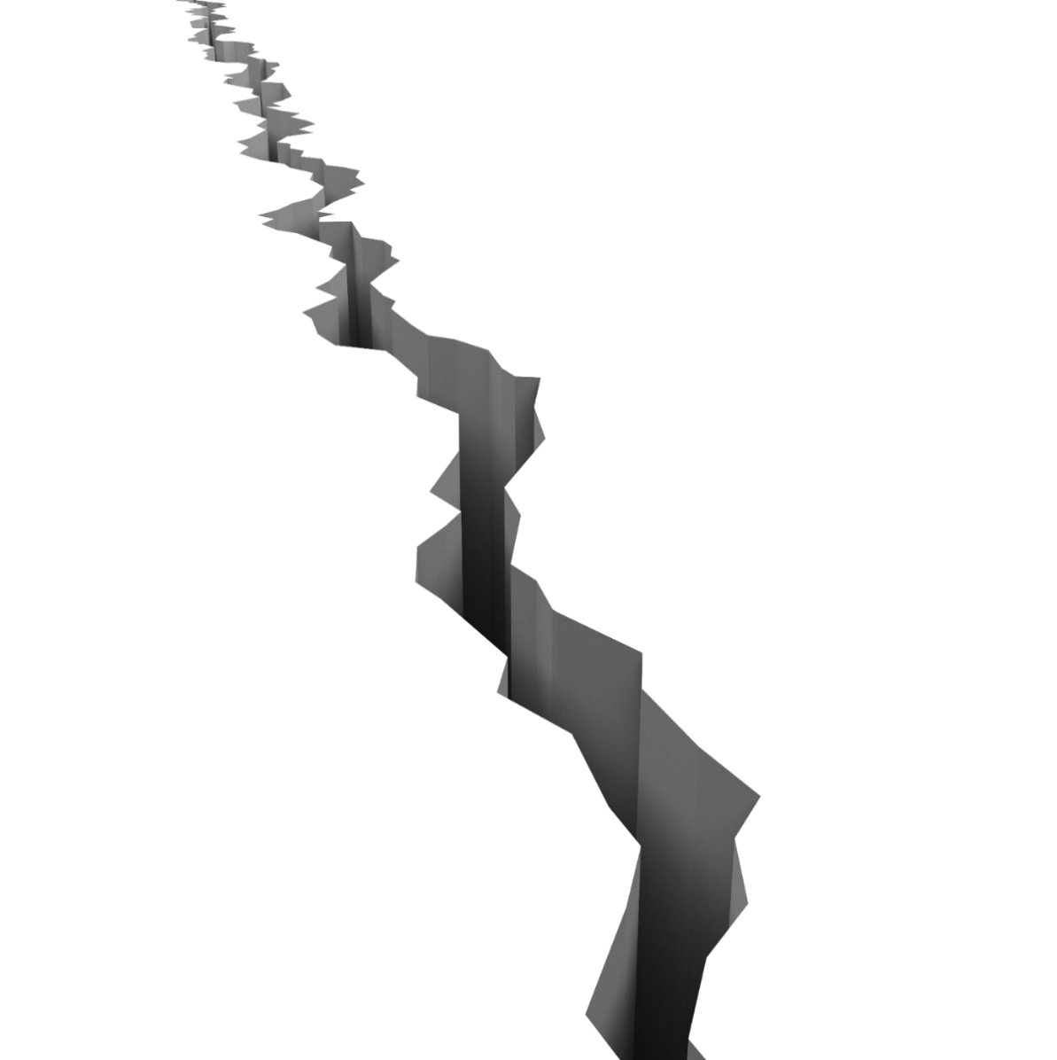
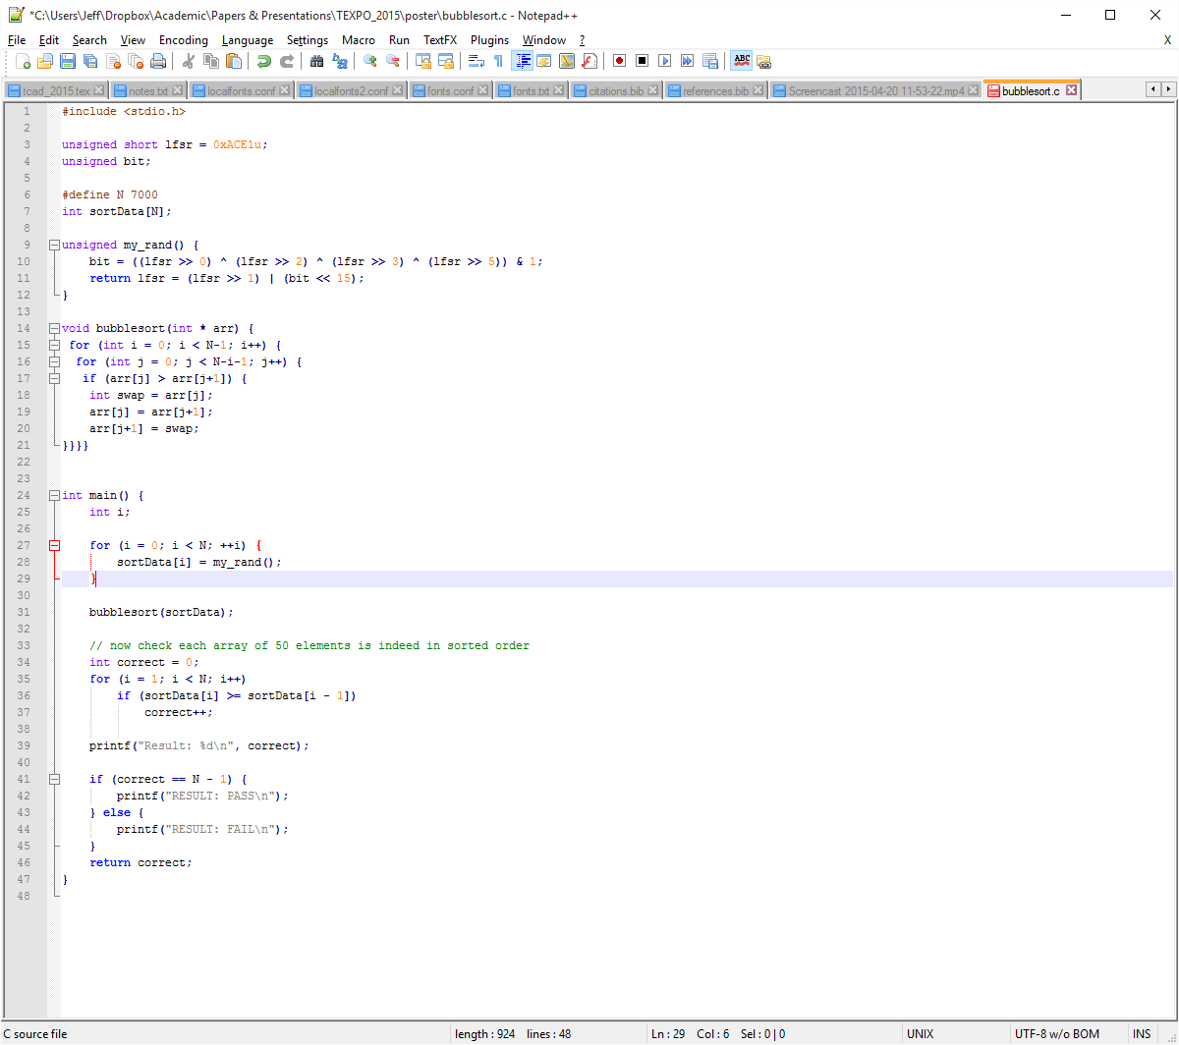



High-Level Synthesis to the rescue!
HLS
Software
Hardware
(FPGA)
Automatic software → hardware compilation
- Converts C code to Verilog code
- Verilog can then be compiled using a normal synthesis tool (eg. Quartus II)
HLS isn’t new, but now it’s in the spotlight
  Gives software developers access to hardware
  FPGA vendors are now heavily invested
Page <number>

Slide 5




Software
Hardware
Slower Execution
Higher Power
Faster Execution
Lower Power
Development Process
  Simple
    Sequential model
    Abstracted memory
    Timing abstracted away
    Hardware abstracted away
  Rapid Development
Development Process
  Complex
    Complete parallelism
    FSMs, memories, etc
    Cycle-by-cycle operation
    Timing considerations
  Long development time
Slide Set 19, Page <number>

Slide 6
High-Level Synthesis: Why?
Software designers out-number hardware designers by 10x
Allows hardware designers to be more productive
Simplifies mixed hardware/software design exploration
Ideally, software designers could design hardware without knowing anything about the hardware.
Challenges for S/W designers:
- Debugging
- Optimizing
- Interfacing with real-world
Today, it is typically sold as a productivity-enhancer for h/w designers
Slide Set 19, Page <number>

Slide 7
High-Level Synthesis (HLS): History
HLS has been used for a few decades
  Propriety formats, used internally at IBM, NEC…
  Release of general purpose HLS tools:
    Impuse Accel Techn. (2002), Cadence C-Silicon (2008), Altera C2H (2009), Y Explorations eXCite (2002), Synopsys Symphony C, Behavioural compiler…
  FPGA Vendors: Altera OpenCL, Xilinx Vivado HLS
  “Xilinx removes the difference in programming models between a processor and an FPGA.”
  - Xilinx Vivado User Guide
Slide Set 19, Page <number>

Slide 8
An important distinction… these all kind of look like C
Verilog (Register-Transfer Level) Design
vs.
Writing C software on an embedded processor
(eg. Lab 6)
vs.
High-Level Synthesis: Creating hardware from C
Verilog kind of looks like C, but you need to think carefully about timing.
- Leads to strict
“synthesizable code”
rules
This truly is software: suffers speed and power overhead of fetching instructions and fixed datapath
Specification is C, but ideally, you get the benefits of a custom hardware design (speed, power)
Slide Set 19, Page <number>

Slide 9
FPGA High-level synthesis: Current state of the art
Xilinx and Altera both offer HLS tools:
Xilinx Vivado HLS
Altera OpenCL SDK
Both built using the LLVM compiler framework
- Likely many of the same optimizations used in both tools
Many people think this stands for “Low Level Virtual Machine” but the designers insist it is not an acronym. Used by many companies including Apple, Nvidia, etc.
Slide Set 19, Page <number>

Slide 10
Common problem with all HLS tools: straightforward sequential
software specifications don’t expose parallelism, and may not reflect
the best way to implement in hardware.
Ideally, an HLS tool would be able to mimic a hardware designer and restructure the code (sometimes extensively) in order to build an optimum hardware architecture.
This is very difficult, and to get good results, today, the designer has to
either use a predetermined framework to specify parallelism (eg.
Altera’s OpenCL compiler) or give “hints” (eg. Xilinx’s pragmas).
Slide Set 19, Page <number>

Slide 11
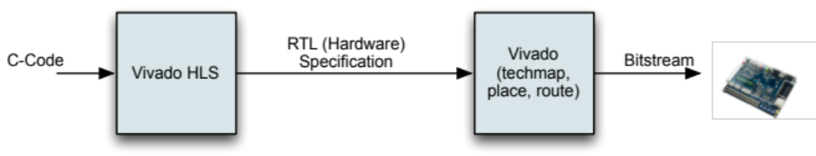
Xilinx Vivado HLS
Spawned from research at UCLA, acquired by Xilinx in 2011
Language support: C, C++, System C
“Traditional HLS”: Generate hardware for one or more C functions and
their descendants
User must integrate HLS-generated core into system
Slide Set 19, Page <number>

Slide 12
Controlling HLS Algorithms
Use pragmas embedded within the code
Example: to turn on loop-pipelining:
// matrix multiplication of a A*B matrix
a_row_loop: for (int i = 0; i < A_ROWS; i++) {
b_col_loop: for (int j = 0; j < B_COLS; j++) {
sum_mult = 0;
a_col_loop: for (int k = 0; k < A_COLS; k++) {
#pragma HLS pipeline II=1
sum_mult += in_a[i][k] * in_b[k][j];
}
out_c[i][j] = sum_mult;
}
}
Slide Set 19, Page <number>

Slide 13
Other Pragma Examples:
PIPELINE: pipeline a loop
UNROLL: unroll a loop
ARRAY_PARTITION: partition an array into multiple arrays for parallel access
ARRAY_MAP: map multiple arrays into a single array
INLINE: inline a function
LATENCY: set the scheduling latency
ALLOCATION: set the # of HW instances of something
Slide Set 19, Page <number>

Slide 14
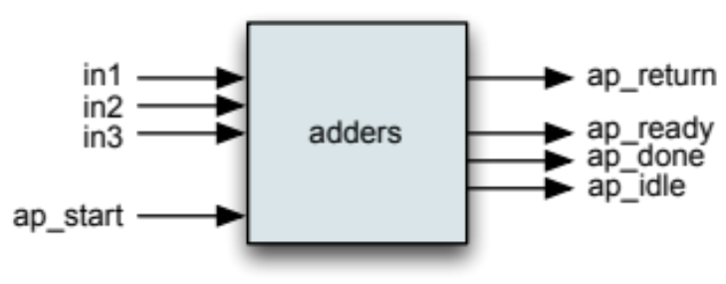
Interfaces to Synthesized Hardware:
To connect inputs and outputs to FIFOs:
void fir( volatile ap_uint<10> * x,
volatile ap_uint<10> * y)
{
#pragma HLS INTERFACE ap_fifo depth=19 port=x
#pragma HLS INTERFACE ap_fi fo depth=19 port=y
…
Can also specify that some parameters are to follow AXI standard: - Lite, Stream, Master
Can control block-level interfaces:
int adders(int in2, in2, in3) {
return (in1+in2+in3);
}
Slide Set 19, Page <number>

Slide 15
Altera OpenCL SDK
OpenCL – Open Computing Language
-- Widely used for GPU programming
-- Allows Altera to compete directly with GPUs as compute accelerators
Host Program runs on an x86 processor, invokes “kernels” on compute devices
Key concept: Each piece of work is “indexed” in an N-dimensional space
- Each point in space is called a “work item”
- eg. Vec2[i] = vec2[i] + vec1[i] // each add is a work item
- Kernel specifies computation for one work item
C function describing work to be accelerated
Slide Set 19, Page <number>

Slide 16
Altera OpenCL SDK
General Approach:
  Host allocates memory on device for kernel input/output
  Transfers input data to device
  Invokes kernel
  Transfers output data back from device
__kernel void sum(const int size, __global float * vec1,
__global float * vec2) {
int ii = get_global_id(0);
if (ii < size)
vec2[ii] += vec1[ii]; // handle one work-item
}
Slide Set 19, Page <number>

Slide 17
Kernel Implementation
Focus is on heavy pipelining and keeping hardware busy at all times
Pragmas to control:
Loop unrolling
Loop pipelining
Managing the amount of hardware resources used
Vectorize code (SIMD parallelism)
Optimize DRAM accesses
Slide Set 19, Page <number>

Slide 18
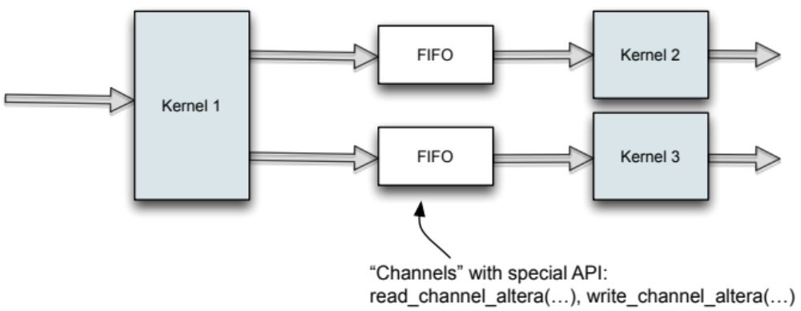
Kernel-to-Kernel Computation
Consider a “streaming” scenario:
datainput -> kernel1 -> kernel2 -> output
Normally, in OpenCL, host processor must manage the data transfers
Altera provides more efficient handling for this:
Slide Set 19, Page <number>

Slide 19
Does this sound like something people that have never taken
CPEN 211 / CPEN 311 could really do?
Slide Set 19, Page <number>

Slide 20
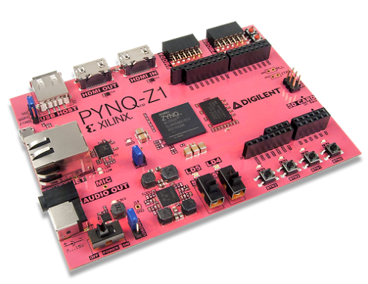
Not just C: Xilinx Pynq:
Python on Zynq:
(Zynq is Xilinx’s chip that contains an embedded processor).
Although this is an interesting
project, it does NOT convert
Python to hardware. It just
runs Python on the embedded
processor.
Slide Set 19, Page <number>

Slide 21
LegUp HLS
HLS framework that takes a C program as input, and compiles to
  1) hardware alone, or…
  2) a hybrid processor/accelerator system
  License for non-commercial research purposes
  Being commercialized by “Legup Computing Inc”.
http://legup.eecg.toronto.edu
Supported | Unsupported
Functions | Dynamic Memory
Arrays, Structs | Recursion
Global Variables
Pointer Arithmetic
Floating Point
Slide Set 19, Page <number>

Slide 22
Support for Debugging
High-Level synthesis sounds great but…
how does a software designer debug and optimize?
This is challenging:
  Circuit looks nothing like the original software
    Software is fundamentally different than hardware
    Many transformations and optimizations performed during HLS
  Debugging hardware is difficult
    Limited observability within a chip
Without a suitable ecosystem for debug, hardware acceleration using
FPGAs is doomed.
Slide Set 19, Page <number>

Slide 23
Bugs in HLS systems
main() {
int i;
}
Kernel-level bugs
  Self-contained
  Debug in isolation
  Easy to reproduce
Debug C code on workstation (gdb).
Software
HLS
RTL-level bugs
  C/RTL mismatch
  HLS tool errors or usage errors
Run C/RTL co-simulation on workstation.
HLS Generated
RTL
Simulation
I/O Devices
System-Level Bugs
  Bugs in interfaces
  Dependent on:
    I/O data patterns
    Interaction timing
  Hard to reproduce, or require long run times
Debug on FPGA
(Requires observing internals of FPGA)
FPGA
HLS Generated
Hardware
Hardware
Other Hardware
Other Hardware
These are the difficult bugs
Slide Set 19, Page <number>

Slide 24
FPGA vendors have provided tools that address the first two categories
of bugs (Xilinx has a framework called SDAccel).
Debugging System-Level bugs is still challenging
Slide Set 19, Page <number>

Slide 25

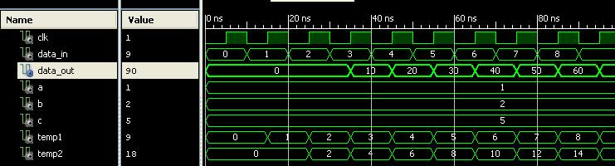
Can We Use Hardware Debug Tools?
Embedded Logic Analyzer (ELA):
Your
RTL
Circuit
Debug Tool:
- Chooses signals to trace
- Debug circuitry added
Run
Designer is forced to debug using the hardware
  Understanding the hardware is time consuming
    HLS optimizations means hardware looks nothing like the C code
  Beyond the expertise of software developers
Slide Set 19, Page <number>

Slide 26
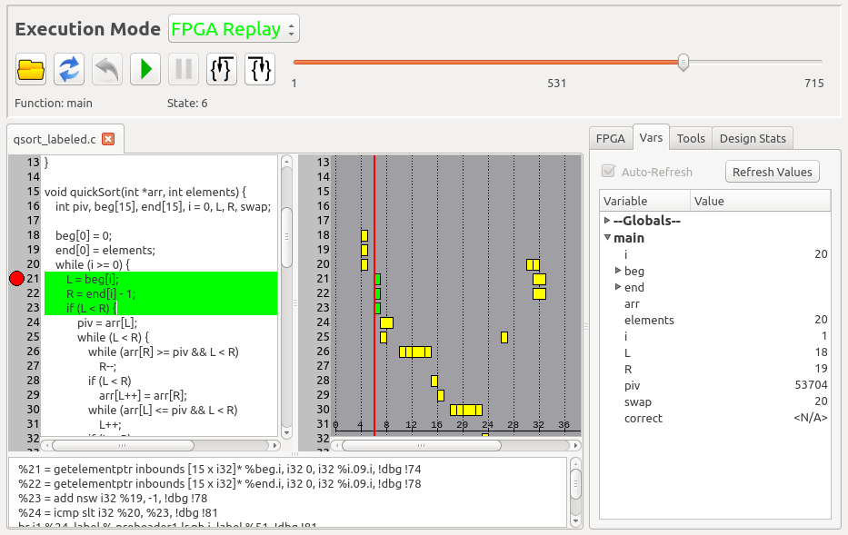
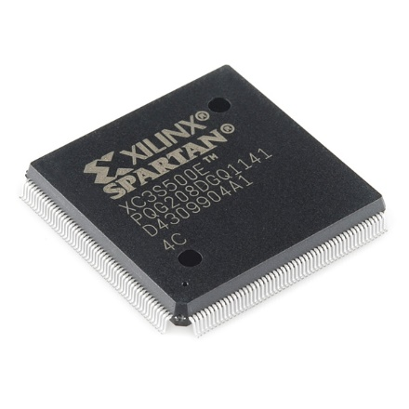
On-Going Research in this area: Project at UBC
Framework for source-level, in-system HLS debugging
  Source-level: Using the original software.
  In-system: Circuit needs to execute in place, at speed.
HLS
2. Stop and retrieve
1. Execute and record
3. Debug using the recorded data
On-Chip Memory
Slide Set 19, Page <number>
Notes:
If the circuit is executing at-speed, running at MHz speeds, obviously the user cannot interact with it at that rate.
So instead we use a solution where execution is recorded, and the user debugs using the recording.

Slide 27
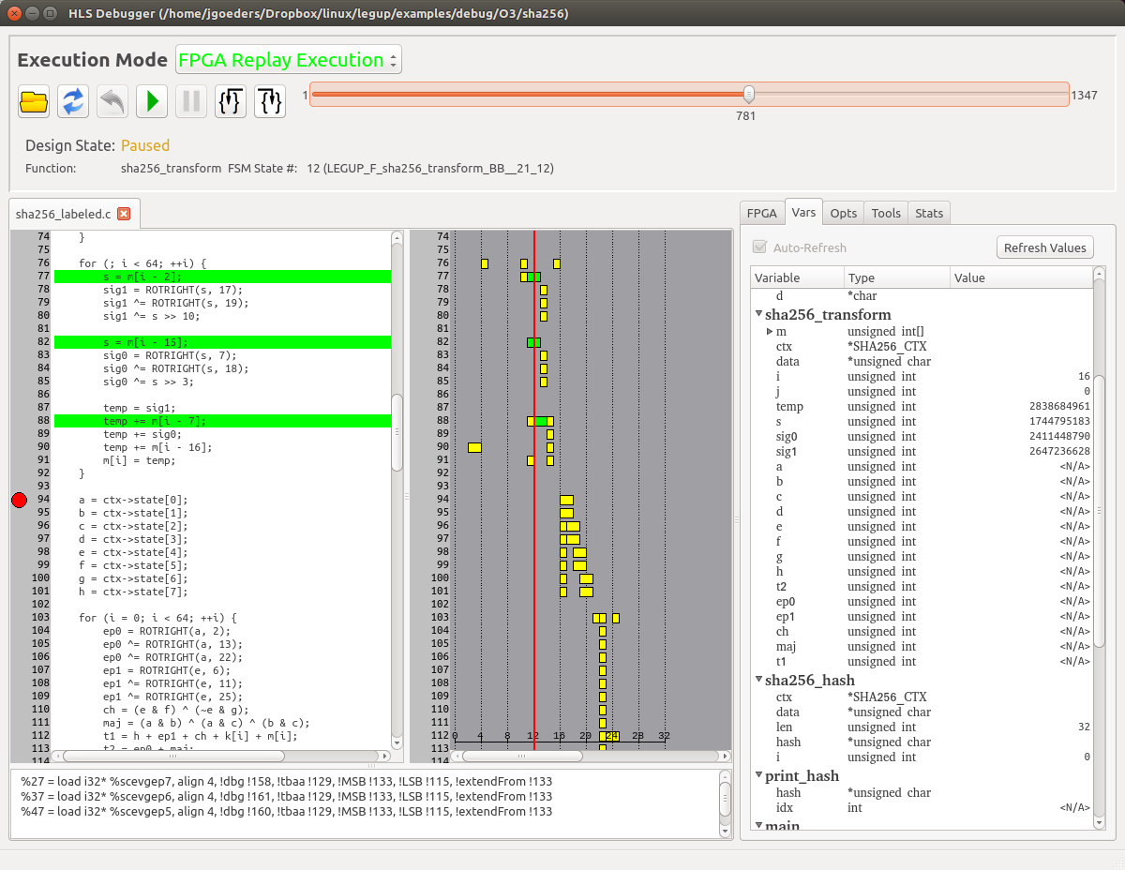
Captured Execution Window
Step through source code
Breakpoints
View assembly
Instruction Scheduling
Inspect variables
Notes:
User perspective.
How we help the user understand the hardware:
Highlight multiple lines of execution
Gantt chart
Underlying IR code
Replay mechanism

Slide 28
Summary: High-Level Synthesis
Provides a mechanism for benefiting from hardware acceleration without
having to design hardware.
Are we there yet?
- Still need to design the entire system. Interfaces with legacy blocks
- Correct pragma settings need careful attention
- Often out of the comfort zone of software designers
- There is work on “machine learning” best pragma settings
Today, high-level synthesis may be best suited for increasing productivity
of hardware designers.
Slide Set 19, Page <number>

Slide 29
Learning Objectives
Learning objectives for this slide set:
1. To understand how high-level languages can be used to improve
programmer productivity
2. To understand the limitations and advantages of high-level synthesis
3. To have a high-level understanding of where this technology is today.
4. To understand some of the challenges that exist using HLS tools
5. To understand, at a high level, how high-level synthesis tools convert C to
hardware
The intention is not to give you enough information to design something using HLS
But, when you get out in the real world, you might have to make the call: for a given
project, should your company stick with current hardware-design tools, or should you
try this “new” approach? This slide set will give you a start at gathering information to
make this decision.
Slide Set 19, Page <number>

